Slide 1

Database Performance Tuning
October 9-11, 2011
Tom Powers
IT Applications Team Manager
Southeast Christian Church
Louisville, KY
tpowers@secc.org
What’s Twitter?

Slide 2

System.Threading.Thread.Sleep(∞)
I just want to _____
Why
are you
so ______
slow?
You piece of _____
For the love of ____

Slide 3

Assess the Situation
Who is affected?
When did it happen?
What were you running?
How does this compare?
Why should I care?
Where are my pills?

Slide 4

Look on the Surface First
What has changed?
Arena upgrade
Network
Environment
Running Process
Nothing

Slide 5
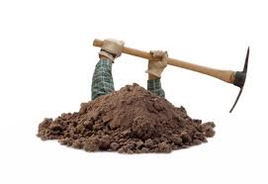
Then Start Digging
Built-in SQL tools
System SProcs and Commands
Activity and System Monitor
SSMS Database Reports
Management Data Warehouse
Dynamic Management Views/Funcs
Extended Events
SQL Profiler and SQL Trace
SQLDiag
Database Engine Tuning Advisor
http://tinyurl.com/sqltools

Slide 6
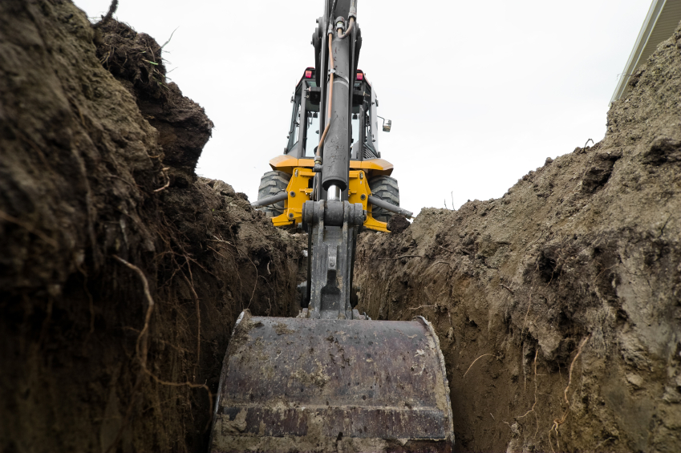
Dig Faster
Third Party Tools
SQLNexus
PAL
Ignite by Confio
Foglight Performance
Analysis by Quest

Slide 7
System SProcs and Commands
sp_who and sp_who2
sp_WhoIsActive (http://tinyurl.com/whoisactive)
sp_lock
DBCC SHOW_STATISTICS
DBCC SHOWCONTIG
DBCC SQLPERF

Slide 8
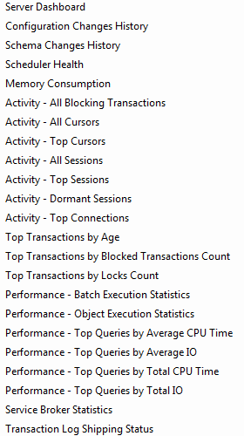
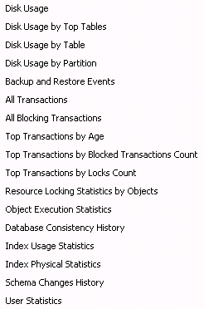
SSMS Database Reports
Server
Database
Who
knew?

Slide 9
Dynamic Management Views/Funcs
CLR
I/O
Database Mirroring
Query Notifications
Database
Replication
Execution
Service Broker
Full-Text Search
SQL Operating System
Index
Transaction
http://tinyurl.com/dmvqueries1

Slide 10

DMV’s and DMF’s ROCK
I’m a fan of…
sys.dm_exec_requests
sys.dm_exec_sessions
sys.dm_os_schedulers
sys.dm_os_wait_stats
sys.dm_os_waiting_tasks
http://tinyurl.com/dmvqueries2

Slide 11
Wait Types
PAGEIOLATCH _*
OLEDB
CXPACKET
SOS_SCHEDULER_YIELD
WRITELOG
LCK_M_*
BROKER_*
LATCH_*
LOG_*
SOS_*
SQL 2005 – 230
SQL 2008 – 475
http://tinyurl.com/sqlwaits

Slide 12

Prove It

Slide 13
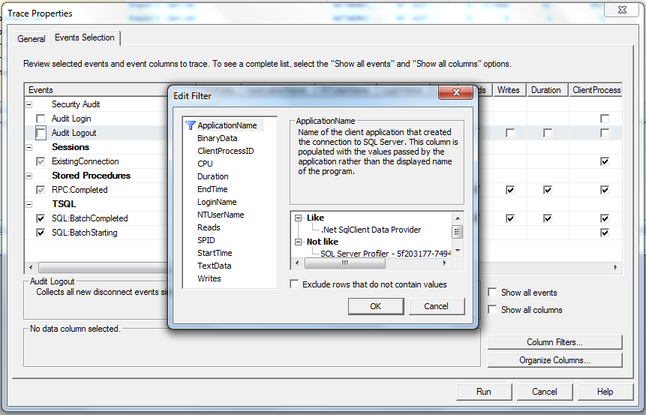
SQL Profiler

Slide 14
Query Optimization Tips
http://tinyurl.com/speedup1
http://tinyurl.com/speedup2
http://tinyurl.com/speedup3
http://tinyurl.com/speedup4
And many more…..

Slide 15
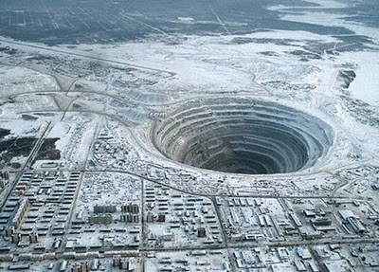
Dig Even Deeper
Tunnel
to
China
Is SQL Server even configured properly?
Microsoft Baseline Configuration Analyzer (MBCA)
Best Practices Analyzer (BPA)
What else can I do?
Consult with a DBA
Glenn Berry, Kevin Kline, Brent Ozar, Thomas LaRock
Up the server resources, patch or upgrade SQL server
Blame Shelby ☺

